Slide 1
TransferService Design Decisions
NatWest Group
Haroldo Macêdo

Slide 2
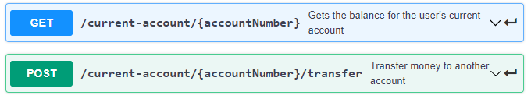
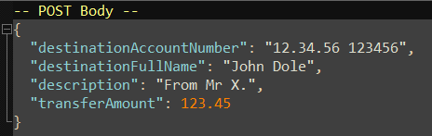
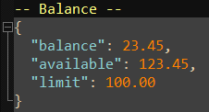
Interface
GET – Returns the balance
Pass {accountNumber} as the user’s account number
Returns the current account balance
POST – Transfer money to another account
Pass
{accountNumber} as the user’s account number
Destination account number and amount goes in the POST body
Returns the current account balance

Slide 3
Introduction
This document describes some decisions taken during design
It uses the format of showing the options and explain the decision to use the chosen option
It is like:
Options
‘Option A’
‘Option B’
Decision
Use ‘Option B’ because ...

Slide 4
Summary of Design Decisions
Resource names
URI
Account number in the path
current-account in singular form
Account number vs Account Id
POST return value
HTTP status code for functional errors
Return error code and body
API Versioning

Slide 5
Resource names – current-account
Options
current-account
account
Decision
Use current-account
This service is for current accounts only
‘savings-account’ and ‘credit-card’ resources may exist in this API
A resource name ‘account’ may still exist
Could be used to group all kind of accounts an user has

Slide 6
URI
Options
Nouns only
Include verbs
Decision
Use nouns only
Follow REST best practices
Defines a resource
Use the ‘transfer’ word as a noun
Transfer can be either a verb or a noun
Here it is used as a noun: the act of moving money between accounts
Notes:
Cambridge: https://dictionary.cambridge.org/dictionary/english/transfer
Oxford: https://www.oxfordlearnersdictionaries.com/definition/english/transfer_2

Slide 7
Account number in the path
Options
Account number in the path
Account number in the body
Decision
Use account number in the path
GET operations don’t have a body
It must be passed in the URL
POST has a body, but it is passed in the URL by this decision
Also for simplicity and coherence

Slide 8
current-account resource name in singular form
Options
current-account
current-accounts
Decision
Use singular for of current account
For simplicity sake
Though plural form is the most common use, it was not chosen
Decision should follow the company guidelines whenever exists

Slide 9
Account Number vs Account ID
Options
Account number in the path
Account ID in the path
Decision
Use account number in the path
Security concern not taken into consideration for simplicity sake
URL is not encrypted and passing the account there number may be a concern
An ID could be used instead
A possible implementation could be to first get all the user’s accounts and their respective IDs, then use these IDs on next API calls
Regulations must be checked and complied, if applied

Slide 10
POST return value
Options
Return resource ID
Return resource URI
Return balance
Decision
Returns balance
Chosen for simplicity sake
Return resource URI would be the REST best practices preferable choice

Slide 11
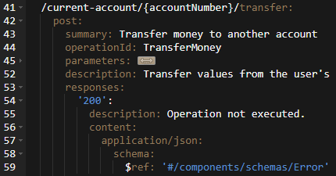
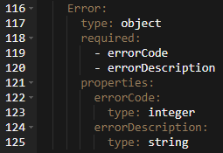
HTTP status code for functional exceptions
Options
Use HTTP-200
Use others HTTP status codes
Decision
Use HTTP-200 for all functional errors
Functional operation may not be successful, but HTTP layer call was OK
Therefore, HTTP-200 should be used instead of other status codes
Default HTTP status code set of values was not designed to handle functional exceptions
It is tricky to use them to return functional exceptions
Use of non default HTTP status codes are not recommended best practice

Slide 12
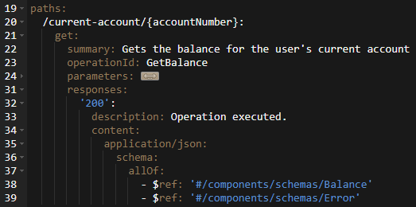
Return error code and body
Options
Error code within the body
Error code and/or body
Decision
Use the error code and/or body
Open API 3.0 allows to describe an interface that sepparates normal return to error codes

Slide 13
API Versioning
Options
Define API version
No API version
Decision
No API version
Important topic, but for simplicity sake, no API version definition

